Slide 1
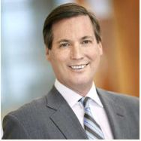
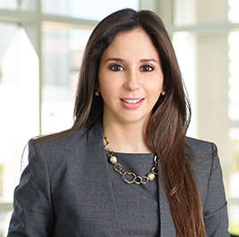
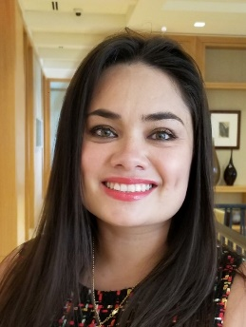
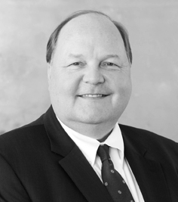
Part II: The Small Business Reorganization Act
Stare Decisis Recent Decisions on the SBRA
Presented by:
Robert Charbonneau - Agentis Legal Advocates & Advisors
Nicole Grimal Helmstetter- Agentis Legal Advocates & Advisors
April Hosford Stone- Agentis Legal Advocates & Advisors
Daniel Sparks - Christian & Small LLP
Thursday, October 29th - 12:00 PM EDT / 4:00 PM GMT

Slide 2
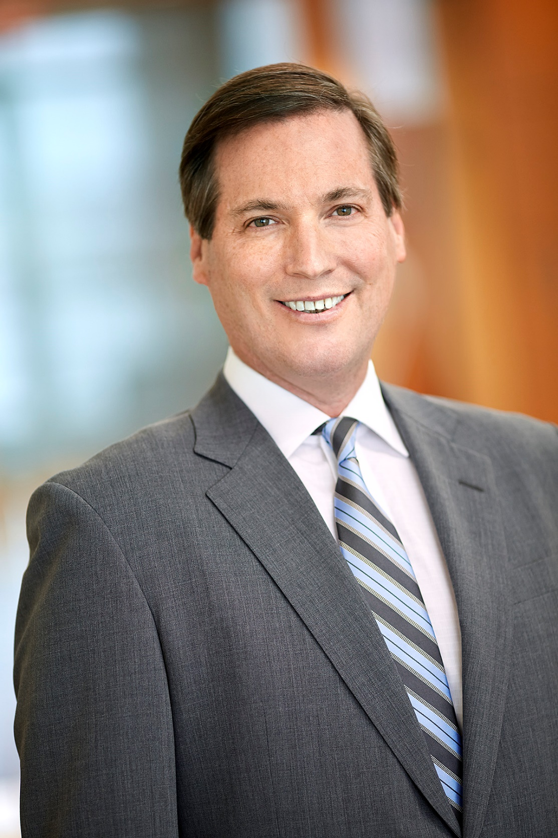
Robert P. Charbonneau Founding Member rpc@agentislaw.com
Robert Charbonneau is a founding member of the Firm. He concentrates his practice in troubled loan workouts, business restructuring and dispute resolution and insolvency matters. He has particularly broad experience representing statutory committees, including creditors’ committees, and funds purchasing distressed debt. Mr. Charbonneau is board certified in both business and consumer bankruptcy by the American Board of Certification.
REPRESENTATIVE MATTERS
Representation of BioNitrogen Holdings Corp. in a Chapter 11 protection matter
Representation of an ad hoc committee of construction lien claimants in the Fontainebleau Las Vegas bankruptcy case. Successfully argued for priming liens in excess of $300 million over the priority of nearly $1 billion in existing bank debt before the Nevada Supreme Court and the two federal courts in Florida
Representation of the creditors committee in Hear USA, a publicly traded hearing aid manufacturer and retailer
Served as counsel to the statutory committee of Deposit Holders in the Levitt Homes bankruptcy case
Lead Debtor’s counsel in the Pan American Hospital case, then the largest independent not for profit hospital in South Florida
Lead Committee Counsel in both the Suncruz Casinos and ITG Vegas cases involving fleets of gambling vessels
On-going representations across the country of a hedge fund in the enforcement of their debt instruments in various Chapter 11 proceedings
EDUCATION
J.D., Boston College Law School
B.A., University of Florida
ADMISSIONS
Florida Bar
United States District Court for the Southern District of Florida
United States District Court for the Middle District of Florida
Eleventh Circuit Court of Appeals
Supreme Court of the United States of America

Slide 3
Nicole Grimal Helmstetter Partner ngh@agentislaw.com
Nicole Grimal Helmstetter concentrates her practice in the area of general bankruptcy, restructuring, dispute resolution and insolvency matters. She routinely represents chapter 7 trustees in the liquidation of local businesses and consumer affairs. Nicole has successfully obtained confirmation of plans of reorganization for several local small businesses, including schools and real estate related companies, and has obtained bankruptcy discharges for high net worth individuals and local business owners. Additionally, Nicole represents creditors’ committees, secured and unsecured creditors, purchasers of assets, lenders and interested parties in chapter 11, chapter 7, chapter 12, and chapter 13 bankruptcy and out-of-court proceedings.
REPRESENTATIVE MATTERS
Representation of BioNitrogen Holdings Corp. in a chapter 11 protection matter
Representation of national clinical research organization in its chapter 11 filing
Counsel to several private school debtors in successful chapter 11 reorganizations
Representation of chapter 7 trustee in the liquidation of construction company, filed over 30 adversary proceedings and produced large returns for creditors
Representation of chapter 7 trustee in the liquidation of an operating real estate company. Coordinated and held competitive auction for the sale of the company’s real estate listings and produced large returns for creditors
EDUCATION
J.D., Florida International University
B.A., cum laude, Florida International University
ADMISSIONS
Florida Bar
United States District Court for the Southern District of Florida
United States District Court for the Middle District of Florida
United States District Court for the Northern District of Florida
Eleventh Circuit Court of Appeals

Slide 4
April Hosford Stone Associate ahs@agentislaw.com
April Hosford Stone’s practice concentrates on the representation of financial institutions, mortgage servicers and other secured creditors in appellate, Chapter 7, 11, 12, and 13 bankruptcy, and litigation. Stone received her J.D. from University of Florida - Levin College of Law, where she graduated cum laude. She was a judicial intern for the Honorable Paul M. Glenn (as Chief Judge of the U.S. Bankruptcy Court for the Middle District of Florida). She graduated magna cum laude from the University of Southern California with a Bachelor of Arts in Classical Studies and Political Science.
PROFESSIONAL AND COMMUNITY ACTIVITIES
Member, Bankruptcy Court for the Northern, Middle, and Southern Districts of Florida
Fellow, Business Law Section of the Florida Bar (Selected as a Fellow for 2019 – 2021)
Task Committee Member for the Proposed Amendments to the Title Certificate Statute
Drafting White Paper with Judge McEwen related to Proposed Amendments to the Florida Foreclosure Statute
Speaker, American Legal & Financial Network, Chapter 11 and Subchapter V (February 2020)
Speaker, Information Management Network, First and Second Lien Positions (January 2020)
EDUCATION
J.D., University of Florida – Levin College of Law
B.A., University of Southern California
ADMISSIONS
Florida Bar
United States District Court for the Southern District of Florida
United States District Court for the Middle District of Florida
United States District Court for the Northern District of Florida

Slide 5
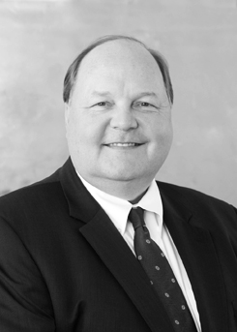
Daniel D. Sparks Partner ddsparks@csattorneys.com
Dan Sparks is head of Christian & Small’s Creditor & Lender Rights Practice Group. He focuses his practice in the areas of bankruptcy and business litigation involving creditors’ rights, consumer finance, lender liability, commercial contracts, and injunctive relief. Dan represents commercial lenders, debt buyers, corporations, Trustees, individuals and other secured and unsecured creditors in all aspects of commercial litigation, loan workouts, restructurings and closings, asset recovery, foreclosure, and adversary proceedings in bankruptcy. He spends a significant amount of his time representing creditors in all bankruptcy courts in Alabama and the Southeast.
AWARDS & RECOGNITIONS
AV® Preeminent Peer Review Rating from Martindale-Hubbell
Recognized in Chambers USA for Bankruptcy/Restructuring: Alabama
Selected by The Best Lawyers in America® in 2018 as “Lawyer of the Year” for Bankruptcy & Creditor Debtor Rights/Insolvency & Reorganization Law
Selected for inclusion in The Best Lawyers in America® 2009 thru 2021 in the fields of Banking and Finance Law; 2009 thru 2011 Litigation – Banking and Finance, Litigation – Bankruptcy, Mortgage Banking Foreclosure Law; 2009 – 2010 Bankruptcy and Creditor Debtor Rights/Insolvency and Reorganization Law; Commercial Litigation 2009
Selected for inclusion in Alabama Super Lawyers® Top 50 Attorneys in Alabama and Top 50 Attorneys in Birmingham
Selected for inclusion in Alabama Super Lawyers® in the field of Bankruptcy and Creditor/Debtor Rights; in Mid-South Region Super Lawyers in 2016-2019 in the field of Bankruptcy, Business
Listed as one of the Birmingham Business Journal’s “Best of the Birmingham Bar”
Listed as “Top Attorney” in fields of banking and bankruptcy for Birmingham Magazine
EDUCATION
J.D., Samford University Cumberland School of Law
B.A., University of Georgia
ADMISSIONS
Alabama Bar
Georgia Bar
U.S. Court of Appeals, 11th Circuit
U.S. District Court, Northern District of Alabama
U.S. District Court, Middle District of Alabama
U.S. District Court, Southern District of Alabama
Georgia State Supreme Court
Georgia Court of Civil Appeals

Slide 6
Eligibility to elect
IN RE: Jeffrey Bernhard Wetter, 2020 WL 6128048 (Bankr. W.D. V.A. 10/14/2020)
IN RE: Tony and Melisa Easter, 2020 WL 6009201 (Bankr. ND Mississippi, 10/09/2020)
IN RE: Seven Stars on the Hudson Corp., 618 B.R. 333 (Bankr. S.D. Fla 8/7/2020)
IN RE: Body Transit, Inc., 613 BR 400 (Bankr. ED PA 3/24/2020)
IN RE: Andrew and Christine Blanchard, 2020 WL 4032411 (Bankr. E.D. LA 7/16/2020)
IN RE: Ellingsworth Residential Community Association, 2020 WL 5743082 (Bankr. M.D. Fla. 7/10/2020)
IN RE: Trepetin, 617 B.R. 841 (Bankr. D. MD 7/7/2020)
IN RE: Ventura, 615 B.R. 1 (Bankr. E.D. NY 8/7/2020)
IN RE: Bello, 613 B.R. 894 (Bankr. E.D. Mich. 3/27/2020)
IN RE: Serendipity Labs, 2020 WL 5900052 (Bankr. W.D. Mich. 10/5/2020)
IN RE: Moore Properties of Person County LLC, 2020 WL 995544 (Bankr. M.D. N.C. 2/28/2020)

Slide 7
Confirmation Issues
IN RE: Pearl Resources, LLC, 2020 WL 5823303 (Bankr. SD Texas, 9/30/2020)
IN RE: Ellingsworth Residential Community Association, 2020 WL 5743082 (Bankr. M.D. Fla. 7/10/2020)
IN RE: VP Williams Trans, LLC, 2020 WL 5806507 (Bankr. S.D. N.Y. 9/29/2020)

Slide 8
Miscellaneous Cases Regarding Trustees, Professionals and Committee
IN RE: Slidebelts, Inc, 2020 WL 4277414 (Bankr. E.D. California 7/24/2020)
IN RE: Bonert, 619 B.R. 248 (Bankr. C.D. Ca. 6/3/2020)
IN RE: Parking Management, 2020 WL 6146476 (Bankr. D. MD. 8/28/2020)
IN RE: Penland Hearing and Air Conditioning, 2020 WL 3124585 (Bankr. E.D.N.C. 6/11/2020)
IN RE: AJEM Hospitality, LLC, 2020 WL 3125276 (Bankr. M.D.N.C. 3/23/2020)

